Slide 1
Book Popularity System
SWEN 5239 - Agile Software Development
Sadia Alam
Stefan Gamero
Eric Prieto
Angel Vazquez

Slide 2
Introduction
Physical libraries and bookstores lack the ability to provide clients with access to other readers' reviews. This application enhances the ability for readers to close the gap between a popular book and a non-popular book. Book Popularity System will also display readers when a book is available and in what format (see Format Example Values). This application can serve as a companion application for people that frequent local bookstores and online readers.

Slide 3
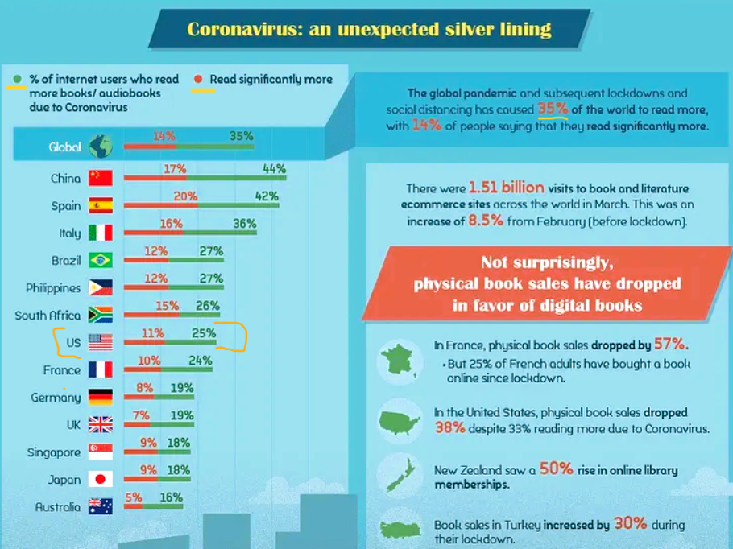
Statement of the Problem
Need for an application that can efficiently recommend books of interest based on certain search criteria.
35% of people are reading more
75% of Americans are reading at least
one book annually
By 2024 500 million apps downloaded daily
Meet growing needs with recommendations
in a continuously expanding library
https://basmo.app/reading-statistics/

Slide 4
Research Questions
DATA TYPES:
BookTitle = String
BookRating = Double
AuthorRating = Double
Genre = String
Format = String
Availability = Bool
Number of Reviews = Int
What are we trying to predict?
Which book is most popular/best seller using various attributes given in the dataset? Popular
Which book is not popular or best seller using various attributes given in the dataset? Unpopular.
What are the attributes and its variable types?
SAMPLE RULES:
Popular List: BookTitle = Not Null, BookRating >= 4 & AuthorRating >= 4, Genre = Not null, Format = AB & HC || AB & EB || HC & EB || AB & HC & EB, Availability = TRUE, Number of Reviews >1000.
Unpopular List: BookTitle = Null || Not Null, BookRating < 4 & AuthorRating < 4, Genre = Null || Not Null, Format = AB || EB || HC, Availability = FALSE, Number of Reviews <=1000.
Where AB = AudioBook, EB = eBook, HC = Hard Copy

Slide 5
Research Questions: Sample Data Example
Id | Book Title | Book Rating | Author Overall Rating | Genre | Format | Availability | Number of Reviews
1 | Why Has Nobody Told Me This Before? | 3.98 | 3.95 | Nonfiction | Audiobook | True | 33000
2 | The Maid | 3.84 | 3.54 | Mystery | Audiobook, Hard copy | True | 30453
3 | Lessons In Chemistry | 4.37 | 4.37 | Fiction | Audiobook, Hard copy, eBook | True | 35323
4 | All Good People Here | 3.91 | 3.85 | Fiction | Audiobook, eBook, Hard copy | False | 10357
5 | Thistlefoot | 4.02 | 3.99 | Fantasy | Audiobook. eBook | True | 1492
6 | The Measure | 4.09 | 4.01 | Fiction | Hard copy | True | 7266
7 | The Trayvon Generation | 4.38 | 4.11 | Nonfiction | eBook, Hard copy | False | 1225
8 | Jackal | 3.65 | 3.98 | Horror | eBook | False | 1000
9 | Call Us What We Carry | 4.35 | 4.30 | Poetry | Audiobook, Hard copy | True | 2634

Slide 6
Intent of the study
The purpose of this study is to determine which books are popular based on these attributes:
Book Rating
Author Overall Rating
Genre
Format
Availability
Number of Reviews

Slide 7
Methodology
SCRUM PROCESS
APPLICATION: Windows Forms App
IDE: Visual Studio 2022
PROGRAMMING LANGUAGE: C#
DATABASE: CSV file
TECHNIQUES: Object oriented programming & Functional programming

Slide 8
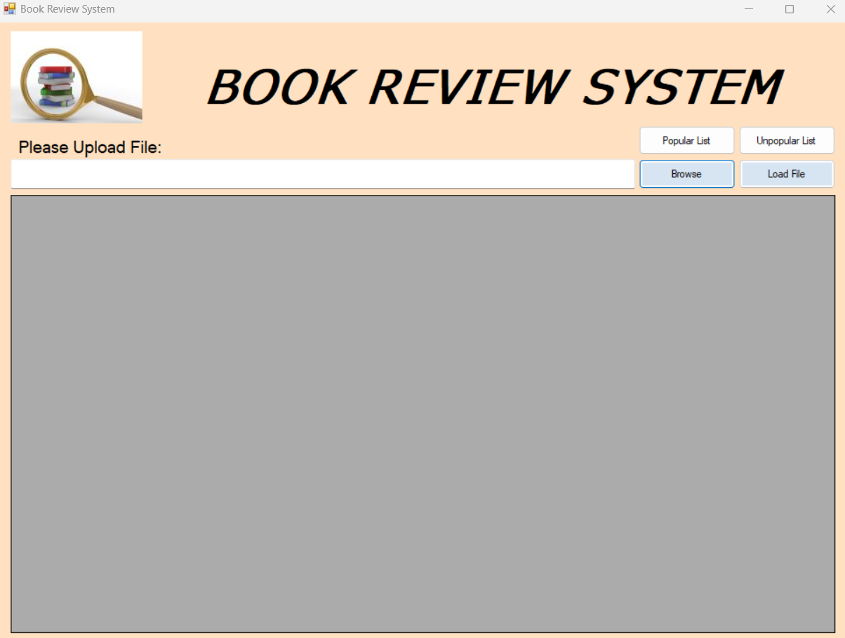
Feature 1
The user will click the “Browse” button and navigate to the desired CSV file to load into the application

Slide 9
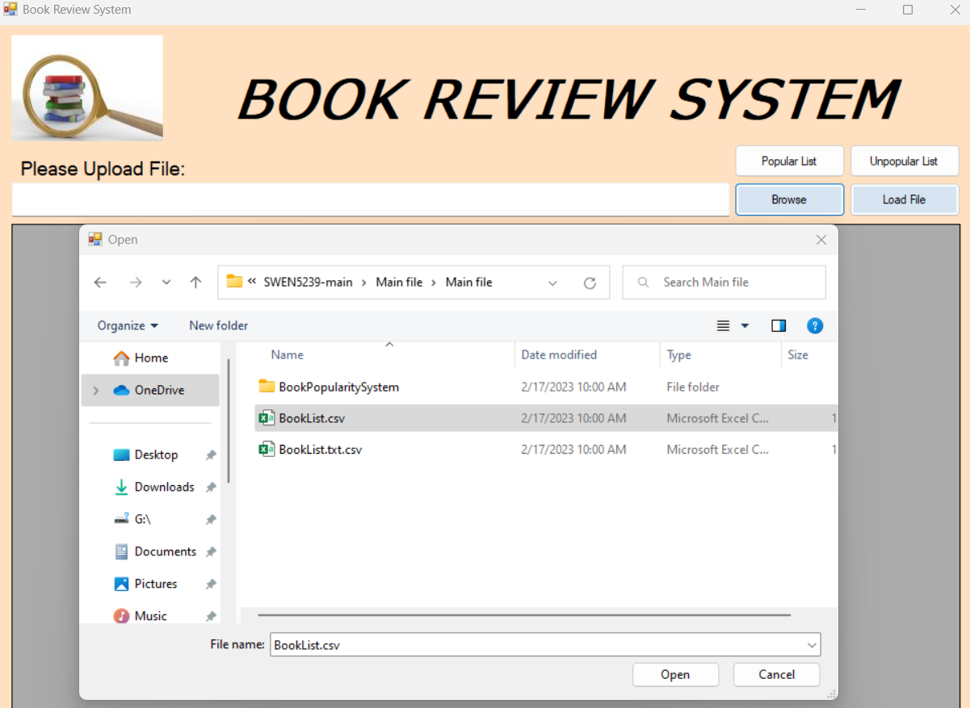
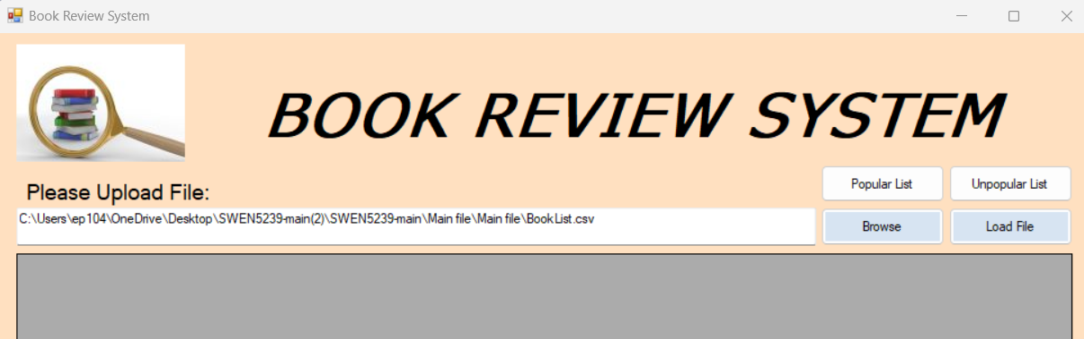
Feature 1 Cont.
Once the user press “Open” the CSV file will be loaded into the application.
The user will then press “Load File” in order to view the content of the file within the DataGridView

Slide 10
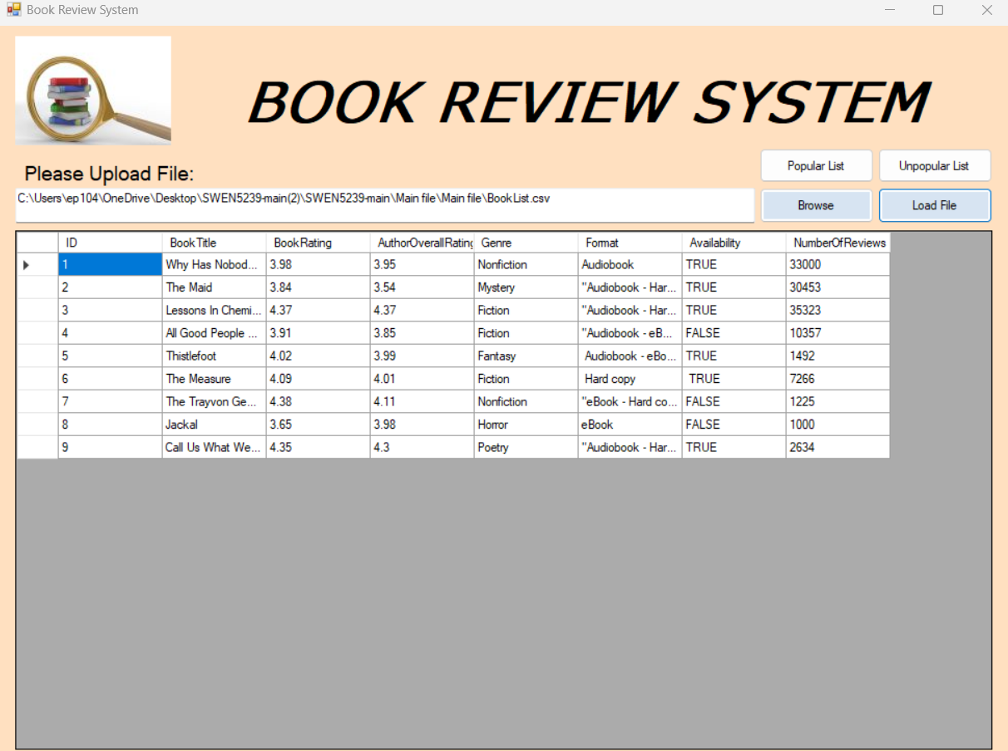
Feature 1 Cont.

Slide 11
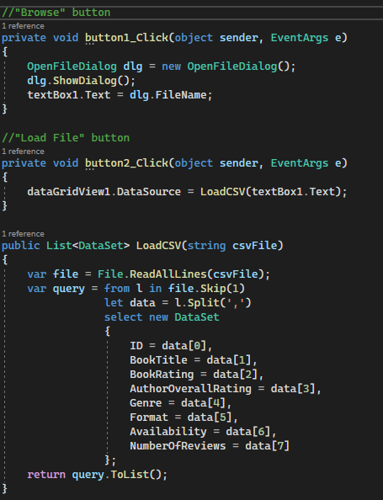
Code Explanation
“button1_Click()” function - defines the behavior when the “Browse” button is clicked.
In this case, a dialog box is opened - allowing the user to browse and select file/s.
“button2_Click()” function - defines the behavior when the “Load File” button is clicked. Calling the “LoadCSV() function.
“LoadCSV()” function - defines the what will happen after the user clicks the “Load File” button and how the data is displayed in DataGridView.
LoadCSV() will return a List data type value.
The “csvFile” variable used as a parameter will store the CSV file specified in the application’s textbox.
Another variable named “file” is initialized with a File.ReadAllLines() method - which will open the CSV file, reads all lines of the CSV file and stores each line into a string array.
Finally, using a Query expression the software will iterate through each of the lines stored in the array

Slide 12
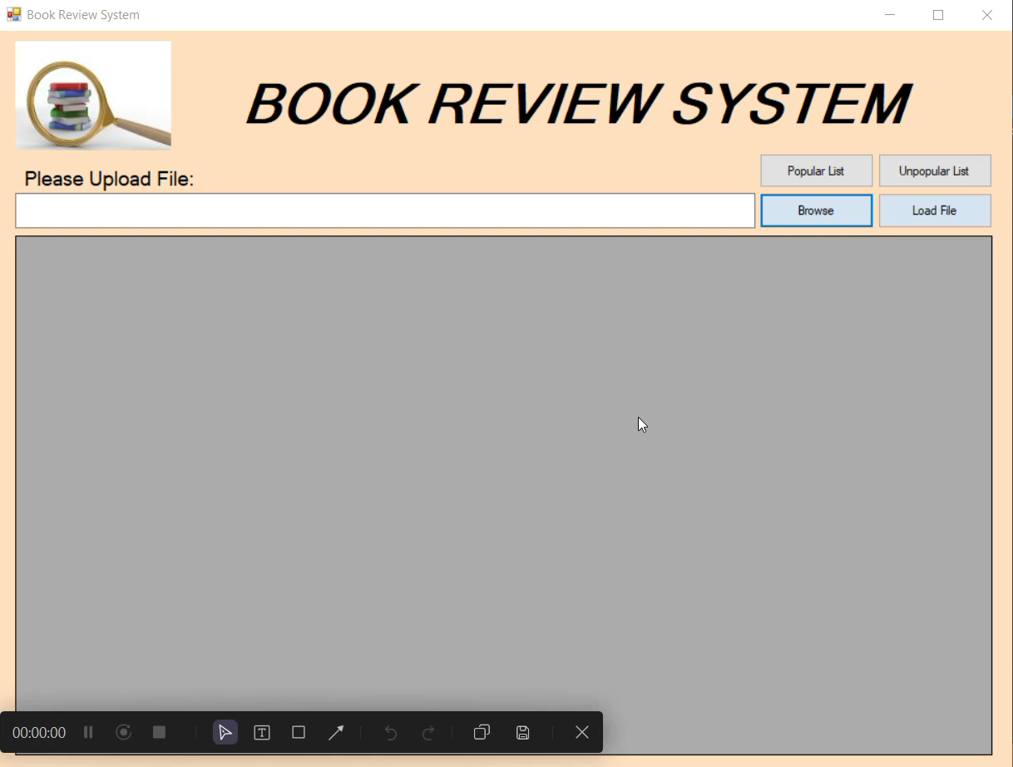
Feature 1 Demo

Slide 13
Timeline
Milestone | Start Date | End Date
Data Attributes | 02/04/2023 | 02/05/2023
Project Proposal | 02/04/2023 | 02/08/2023
User Stories | 02/08/2023 | 02/18/2023
Feature 1 | 02/08/2023 | 02/18/2023
Feature 2 | 02/18/2023 | 02/25/2023
Final Delivery | 02/25/2023 | 03/11/2023

